Slide 1
Disaster Recovery and Bussiness management
NAME:LAD VISMAY
EN. NUMBER:160410116052

Slide 2

Business Continuity Planning
  A business continuity plan specifies how a company plans to restore core business operations when disasters occur
Disaster Recovery
  Disaster recovery looks specifically at the technical aspects of how a company can get back into operation using backup facilities

Slide 3
Types of Backup Facilities
  Hot sites
    Ready to run (power, HVAC, computers): Just add data
    Considerations: Rapid readiness versus high cost

Slide 4
Types of Backup Facilities
  Cold sites
    Building facilities, power, HVAC, communication to outside world only
    No computer equipment
    Might require too long to get operating

Slide 5
Types of Backup Facilities
  Site sharing
    Site sharing with a firm’s sites (problem of equipment compatibility and data synchronization)
    Site sharing across firms (potential problem of prioritization, sensitive actions)

Slide 6
Types of Backup Facilities
  Hosting
    Hosting company runs production server at its site
    Will continue production server operation if user firm’s site fails
    If hosting site goes down, there have to be contingencies

Slide 7
Restoration of Data and Programs
  Restoration from backup tapes: Need backup tapes at the remote recovery site
  Real-time journaling (copying each transaction in real time)
  Database replication

Slide 8
Testing the Disaster Recovery Plan
  The importance of testing: Find problems, work faster
  Walkthroughs
    Go through steps in real time as group but do not take technical actions
    Fairly realistic
    Unable to catch subtle problems

Slide 9

BUSSINESS MANAGEMENT

Slide 10
Role of Business
Input
Process
Output

Slide 11
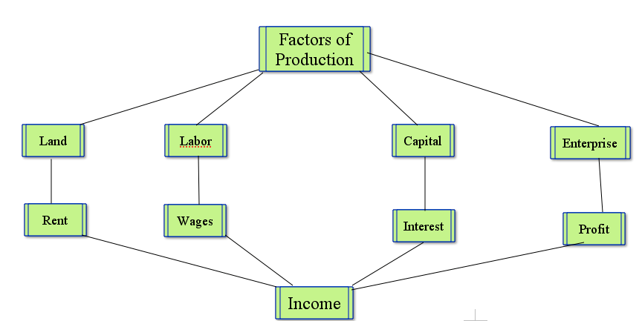

Slide 12
Business
Businesses exist to satisfy the needs and wants of people, organizations and governments
Market
place
Market
Customers

Slide 13
Adding Value
Adding value is increasing price of the products by improving packaging or adding features
It leads to profit making by allowing a business to sell its products
for more than its production costs

Slide 14
Opportunity Cost
This next best alternative foregone while making a choice is known as Opportunity Cost
Because of the fact that choice involves opportunity cost, the factors of production have to be used in the most efficient way and therefore SPECIALIZATION

Slide 15

Division of labor
The separation of a work process into a number of tasks, with each task performed by a separate person or group of persons.

Slide 16
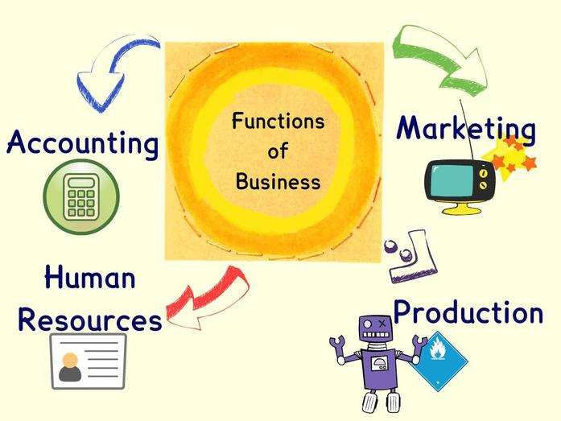
Business Functions
◆ Human Resources (Personnel)
◆ Marketing
◆ Finance
◆ Production (Operations)

Slide 17
Human Resources
◆ Manpower Planning
◆ Job analysis and Job description
◆ Determining wages and
salaries
◆ Recruitment and Selection
◆ Training and Development
◆ Employee welfare and motivation
◆ Labour management
relations
◆ Performance Appraisal

Slide 18
Marketing
◆ Conducting Market Research
◆ Price Planning
◆ Customer Relationship
Management
◆ Identifying New Business Opportunities
◆ Product Planning
◆ Distribution Planning
◆ Consumer Analysis

Slide 19
Finance
◆ Advice on the financial and tax implications of business decisions
◆ Management of wages
◆ Raising Finance
◆ Preparation and monitoring of annual budgets and forecasts

Slide 20
Production
◆ Production and planning
◆ Purchasing department
◆ Stores department
◆ Manufacture of products
◆ Design and technical support department

Slide 21

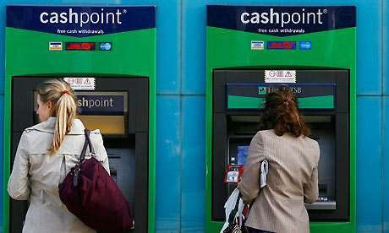
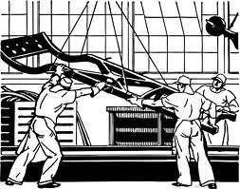
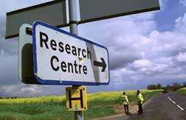
Business sectors
Primary
Tertiary
Secondary
Quaternary

Slide 22
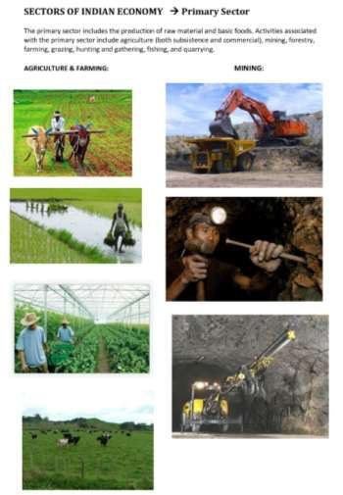
Primary sector
◆ Larger sector in underdeveloped & developing countries
◆ Less capital investment
◆ Less use of machinery
◆ Agriculture constitutes the major part

Slide 23

Factors to consider when setting up business:
◆ Business idea
◆ Finance
◆ Human resources
◆ Entrepreneurial skills
◆ Fixed assets
◆ Suppliers
◆ Customers
◆ Marketing
◆ Legalities

Slide 24
Reasons for starting business
◆ Growth
◆ Earnings
◆ Autonomy
◆ Security
◆ Hobbies

Slide 25
Challenges of start-up business
◆ Obtaining Finance
◆ Market potential
◆ Cash flow problems
◆ Customer Loyalty towards other brands
◆ Regulations
◆ Finding the right staff
◆ Uncertainty

Slide 26
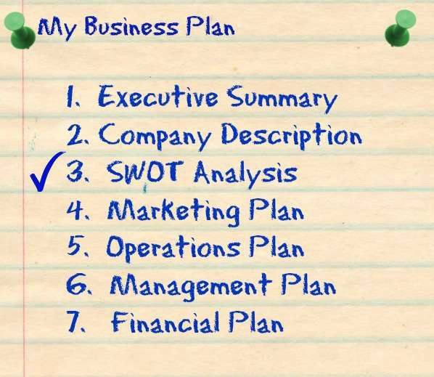
Elements of Business Plan

